Slide 1


Slide 2




3rd Training Seminar
“Management and protection of the Mediterranean Monk Seal
Monachus monachus”
Monk Seal Alliance & Seal Greece : Protecting the endangered Mediterranean monk seal
Auriane Pertuisot
Coordinator of the MSA
Prince Albert II of Monaco Foundation

Slide 3


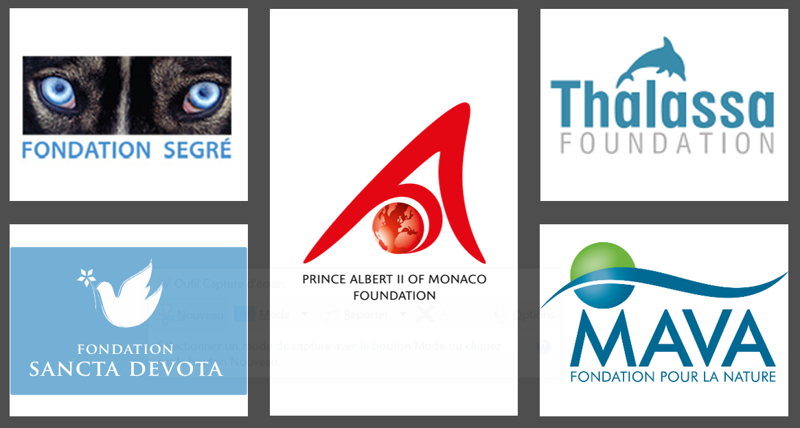
Monk Seal Alliance
Our Vision: “Mediterranean monk seal populations are thriving and key habitats protected”
Our Mission: “By joining forces and becoming the major source of financing of collaborative projects protecting the Mediterranean monk seal throughout its range, the MSA supports the concerted action needed to make lasting impact for this iconic species.”
support projects
enhance collaboration
design and co-lead initiatives (projects/advocacy)
MedDonors : 47M USD over the next 4 years for 30×30

Slide 4
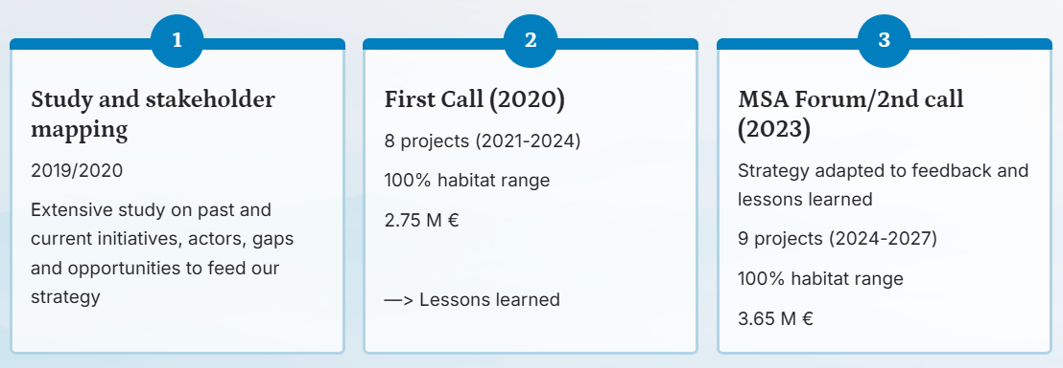
MSA timeline

Slide 5
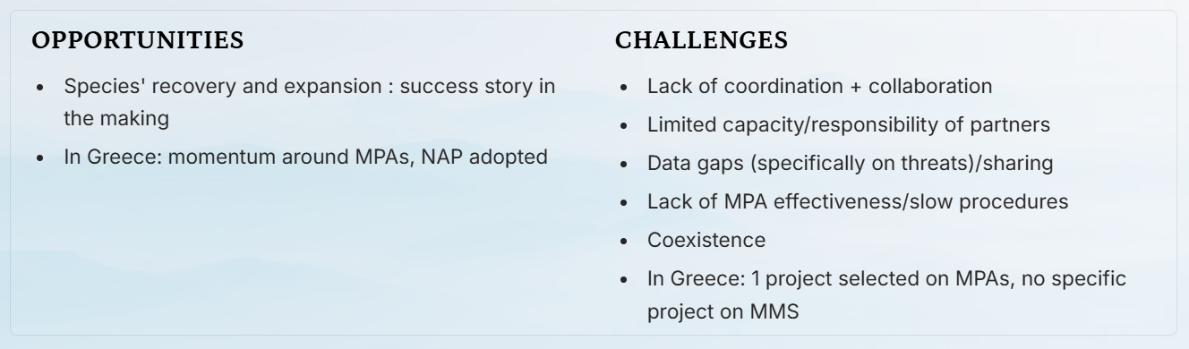

Slide 6

Co-designed and co-led by OFYPEKA and MSA
Dates: 2024-2026
Budget
Phase 1 budget: 60K€
Phase 2 budget: 980K€ secured (MSA)
Rationale: How can urgent conservation and enforcement measures be implemented while the Natura 2000 designation process is still underway?

Slide 7
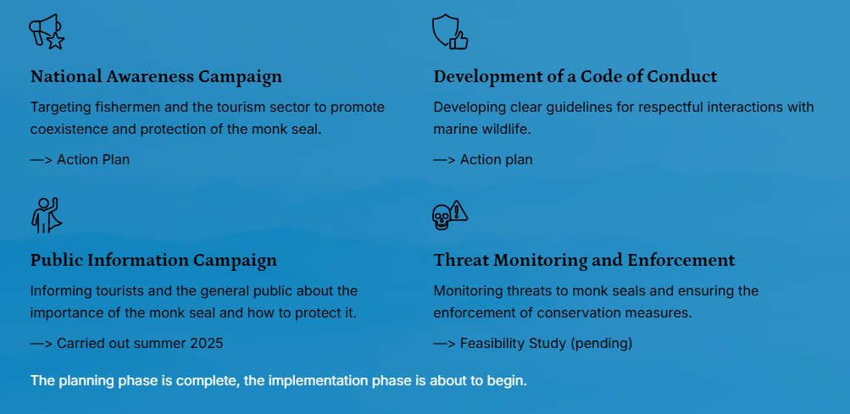

Slide 8
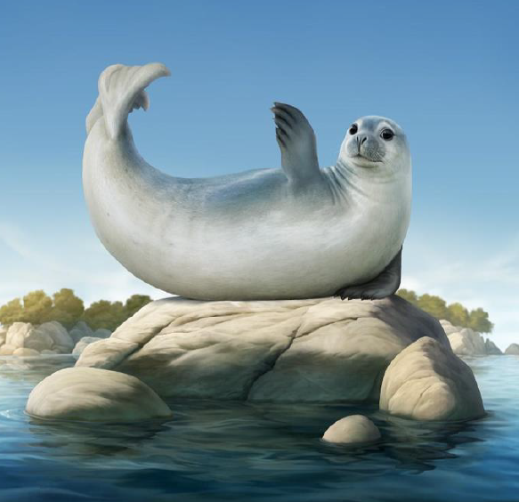

National Information campaign
QR Experience
Interactive QR code experiences for easy access to educational content about monk seals.
Social Media Presence and TV spot
Reaching a wide audience through engaging content on various media platforms.
Sailing Voyage
Reached 26 islands and coastal towns, docked at 31 ports in the Agean and Ionian seas
Information on Navily
Providing essential conservation details through the popular boating application, Navily.
Validation of material/message by international expert group

Slide 9

Thank you for your attention

