Slide 1


Slide 2



3rd Training Seminar
“Management and protection of the Mediterranean Monk Seal
Monachus monachus”
Marine Protected Areas and endangered species protection: a manager’s perspective, with a focus on Seal Greece project
Laurent Sourbès

Slide 3

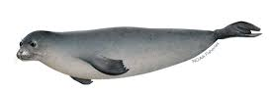
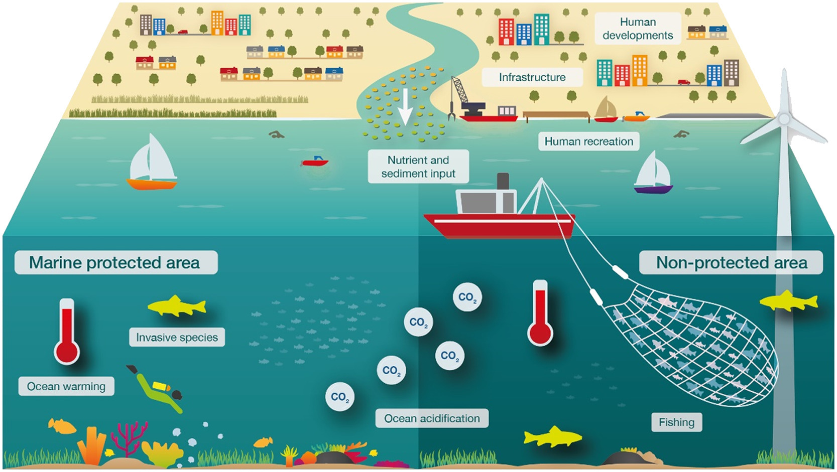
Introduction
Brief context:
  Greece’s rich marine biodiversity
  Importance of Marine Protected Areas (MPAs)
  Status of the Mediterranean monk seal (Monachus monachus)
  – vulnerable (IUCN 2023)
  Priority species (Directive 92/43)
  Protected Species (P.D. 67/1981)
  Monk seal Action Plan ( RAC/SPA 2013, Greece 2024)
Purpose of the presentation:
  Showcase the Seal Greece project's contribution
  Challenges for NECCA’s PAMUs

Slide 4
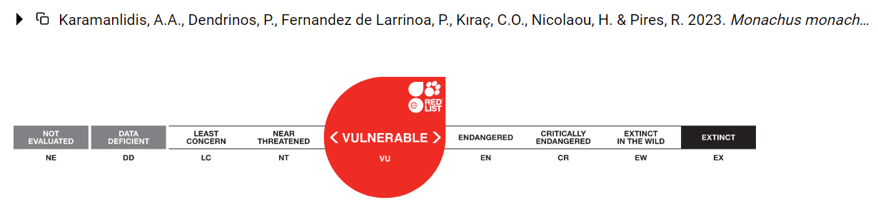
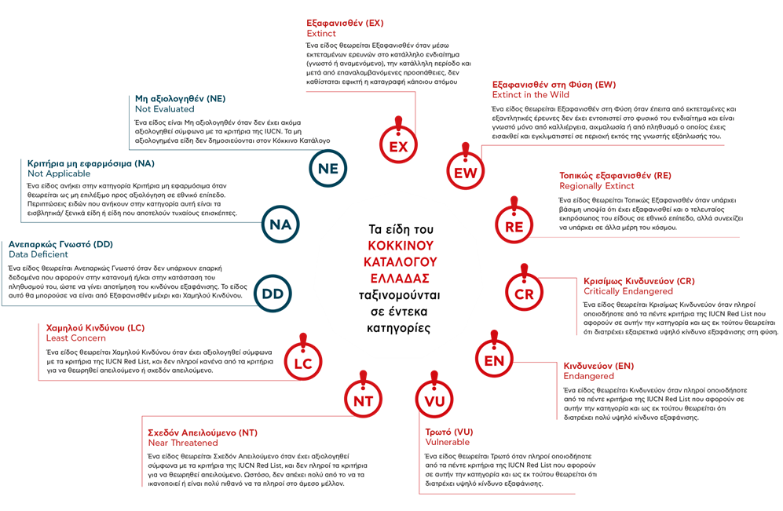
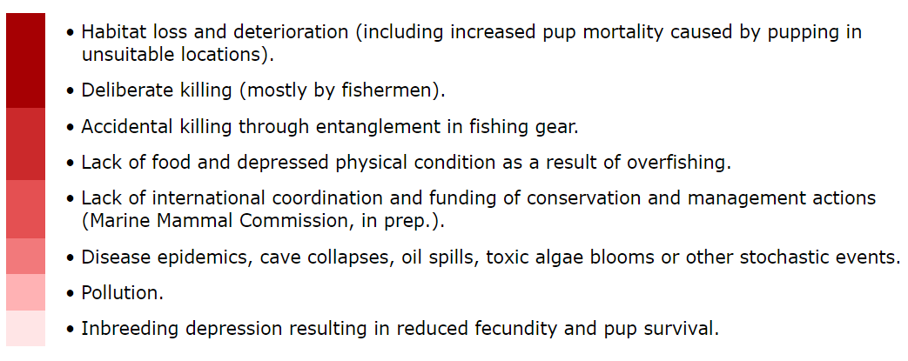
https://www.iucnredlist.org
The Mediterranean Monk Seal
Scientific name: Monachus monachus
Conservation status: Vulnerable (IUCN, Τhe Greek Red List – NECCA)
Critical Habitats: Caves (8330), remote coastal areas
Threats
https://redlist.necca.gov.gr/

Slide 5
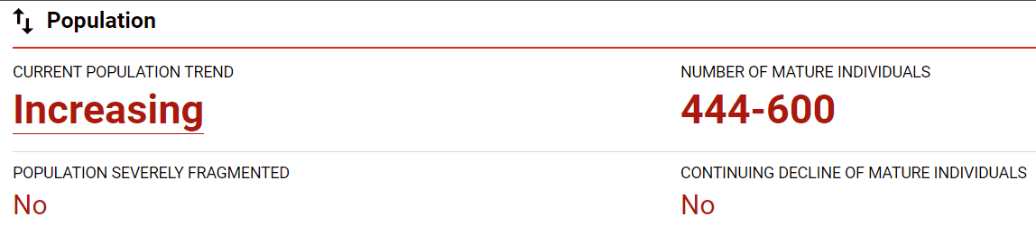
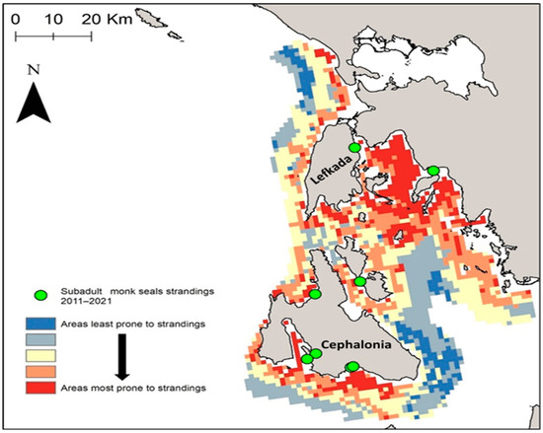
Karamanlidis et al., 2023
https://www.iucnredlist.org
Monk Seal Conservation in Greece
Estimated population (337-450 total Greece-IUCN 2023) and distribution
Key areas of activity (e.g., Northern Sporades, Ionian Islands, Cyclades, Dodecanese) and threats’ hot-spots
Role of MPAs in protecting habitat and species
Solanou et al., 2024

Slide 6

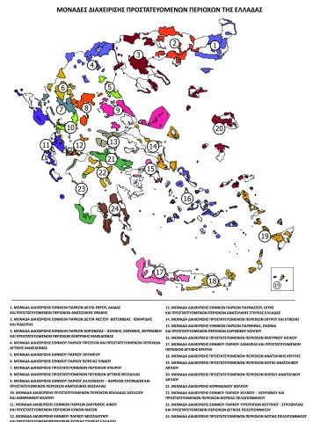
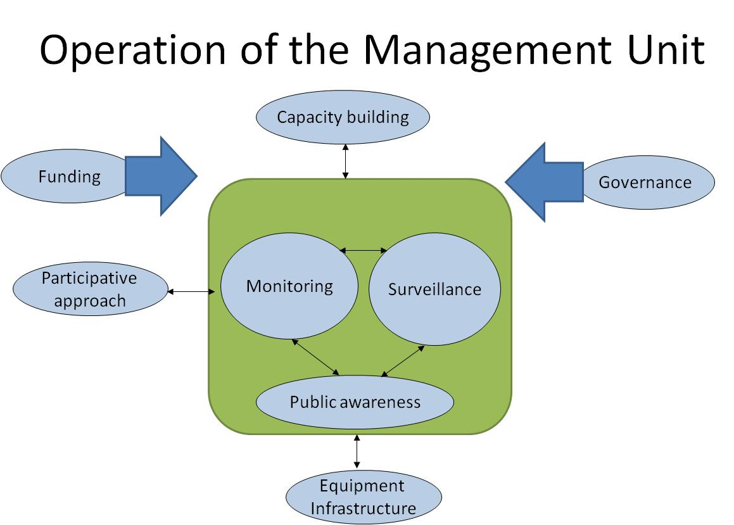
Role of the MPA Manager
Day-to-day responsibilities:
  Monitoring and enforcement
  Participative approach /awareness/environmental education
  Research coordination
  Opinions
Linking conservation, policies, and community needs
Managing conflicts (e.g., fisheries/tourism vs. conservation)

Slide 7
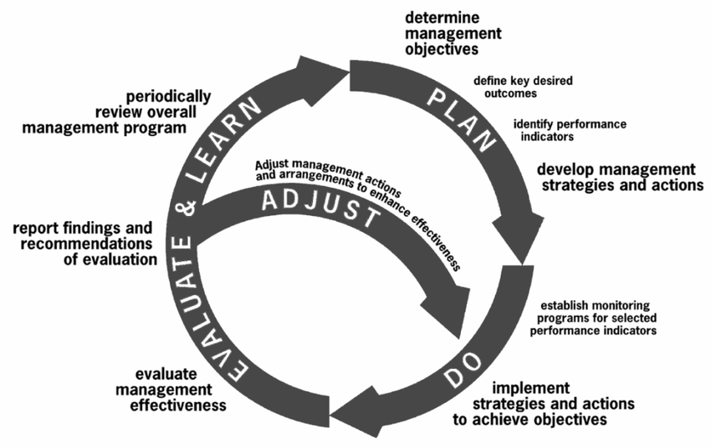
Active/adaptive Management
1. Knowledge of the current conservation status (biology of protected species, socio-economic development of the area, current pressures, etc) (e.g. Survey-scientific articles, NGOs, Life Mare)
2. Planning (Conservation objectives, Mitigation Management measures, scientific monitoring of species and pressures, cost effectiveness of measures)
3. Implementation of Protection Measures
4. Assessment/ Adjustment of management measure

Slide 8
Knowledge of the current conservation status (Multi criteria analysis)
1.2 socio-economic development of the Protected area
Fishing activity
Transports
tourism
Leisure
1.1 Biology of the species
-Resident – seasonal - sporadic
- Life cycle (sex ratio, age of sexual maturity, life expectancy etc)
Geographical distribution (breeding, migratory, feeding, other)
Main habitat (e.g. open sea, cave, reeves, sand)
1.3 Abiotic environment
-temperature
-sea level
Geology
salinity
1.4 Pressures/threats
-killing –injuries (intentional and not)
disturbance (intentional and not)
diseases
loss/suitability of habitat
loss of feeding ground

Slide 9
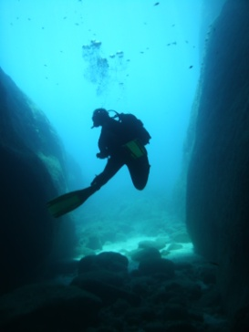
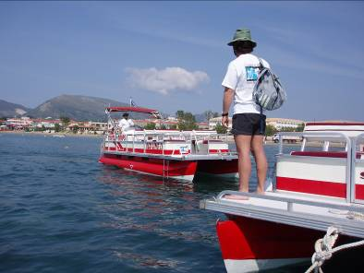
General and Specific Carrying Capacity
Leisure activities :
Sailing – Boating
Sunbathing - swimming
Snorkeling – Diving
Recreational fishing
Hiking
Management Priorities
management of Conflicts
Professional l Activities :
- Buildings - infrastructures
-wildllife spotting
Speed Boats and pedalos (paddle boat) rentals
Boat tours
Fishing
Diving

Slide 10

Introduction to Seal Greece Project: A common approach for improved efficiency
Background and mission (MSA-NECCA memorandum 2023- addendum 2024, Monk Seal Alliance Forum 2023)
When and why it was created (2024): Need for synergies
Target species: Monk seal focus
Core objectives:
  Protection of critical habitats-Important MS areas
  Better knowledge (sensitive species)
  Stakeholder engagement
  Monitoring and research (common protocols)
  Efficiency of Surveillance/enforcement

Slide 11
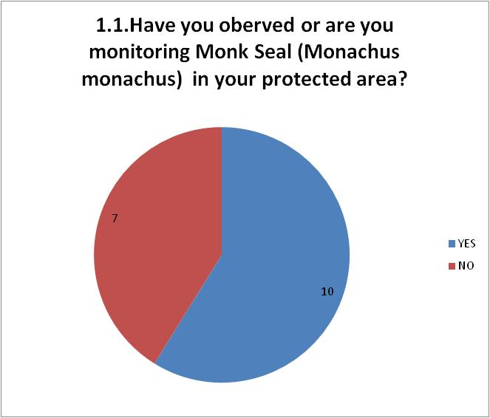
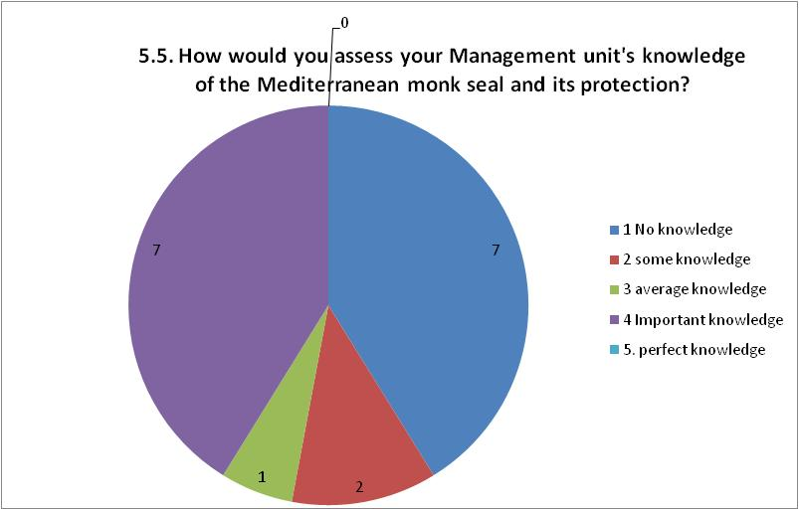
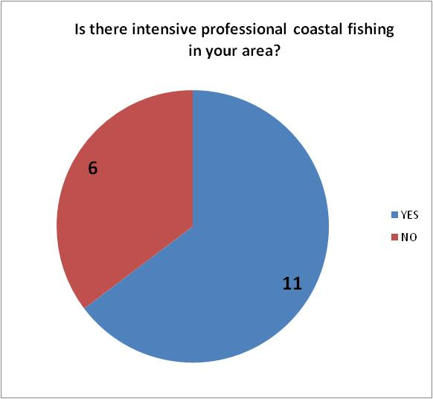
Knowledge of MPAs Managers regarding Monk seal conservation
Questionnaire 2024-2025 (MSA-NECCA)- 17 answers, 13 PAMUs
Do you have any suggestions for strengthening the protection of the Mediterranean monk seal in your area?
Better information for professionals and visitors
Establishment of rules especially for areas with breeding caves
Citizen awareness and prohibition of access to caves
strengthening - intensifying regular controls by the port authority/coast guards
Addressing pressures such as uncontrolled and/or illegal fishing and uncontrolled development of fish farms and the loss of breeding habitats
Updating nautical charts (e.g. navionics) etc. regarding existing fishing bans and local regulations (e.g. Giaros, Formicula)
Employment of additional specialized personnel for monitoring the species
Training of existing Management Unit staff
Protection of habitat 8330 (caves) outside Natura areas

Slide 12
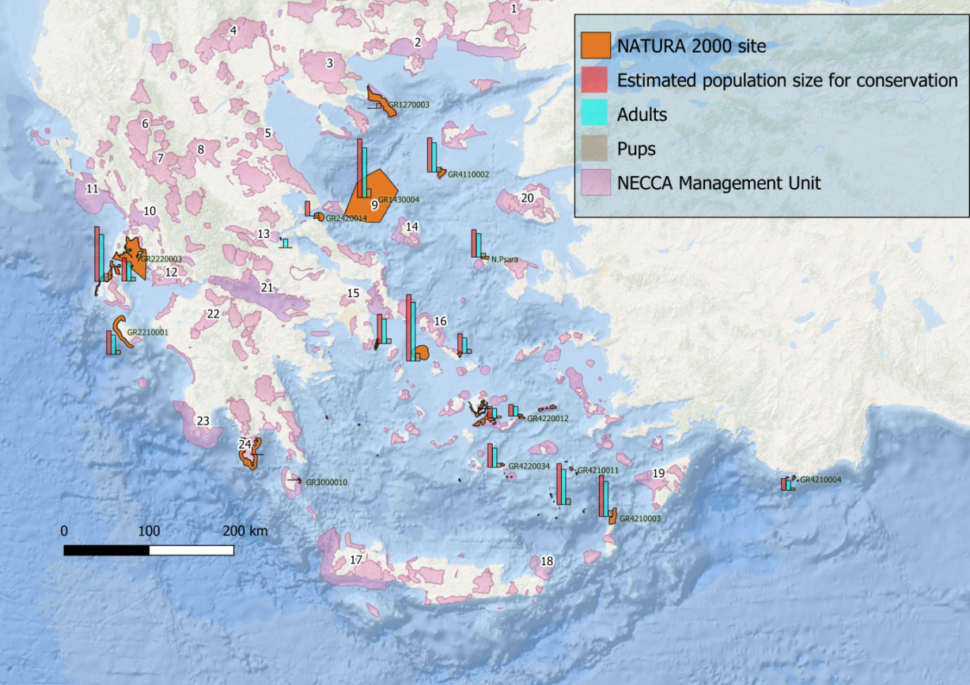
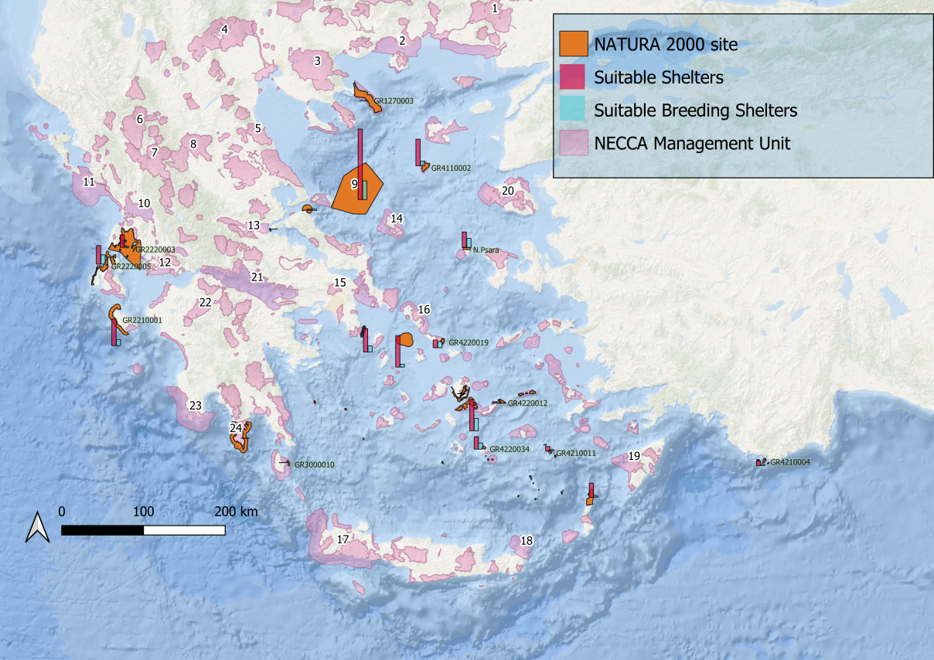
PAMUs and MS Important Areas in Greece
Sources:
Monk seal Conservation objectives OG 1807/Β/2023
Monk seal Action Plan OG 5100/Β/2024
MOM
Seal Greece deliverables

Slide 13
Feasibility study (identifying two IMS areas, implementation of surveillance system/monitoring of threats, improve the response to infringements, etc)
Common Activities and Strategies
Habitat protection: Important areas delineation/signing, restricted access zones; use of technology such as remote cameras, acoustic sensors, drones, etc
Species protection: limit the impact of human activities (e.g code of conduct)
Scientific research: seal population monitoring, data sharing (international platform/IUCN expert group), research permits
Awareness campaigns: schools, fishers, tourists, general public (different approach according to target group and protected area status)
Capacity building
Cooperation with coastguards and local authorities
Action Plan of recurrent awareness campaign at local and national level , capacity building for professionals, code of conduct)

Slide 14
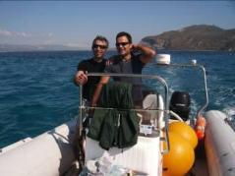


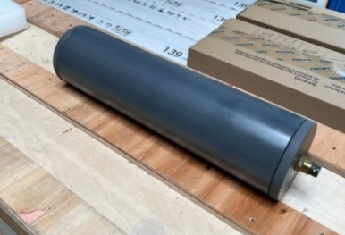
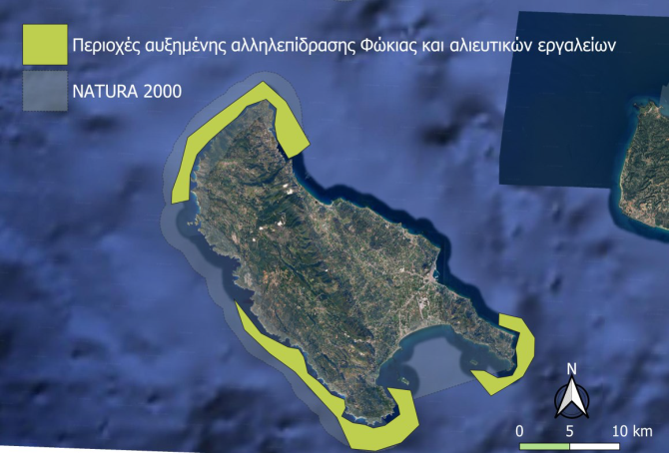
Mazaris Katsevanakis 2025
x
Special Environmental Study at the national Level for Natura 2000 areas
Future Outlook
Planned expansion of protected habitats
Improved on site surveillance and patrolling
Citizen science initiatives
Long-term seal monitoring programs (both MS biology, socio- economics characteristics and threats)
Need for stronger enforcement policy and funding (cost effectiveness study)
On going capacity building of PAMUs staff (e.g Life MareNatura: Management/conservation , photo identification)
Long term cooperation with local stakeholders (e.g. promote the grants for damage in nets, code of conducts, sustainable tourism-certification, support professionals for innovative tools/ mitigation measures MOU)
Special Environmental Study for National Marine Park Ionian sea and Aegean sea (South Cyclades)
(18000+ 9500 km2)
Mazaris Katsevanakis 2025

Slide 15

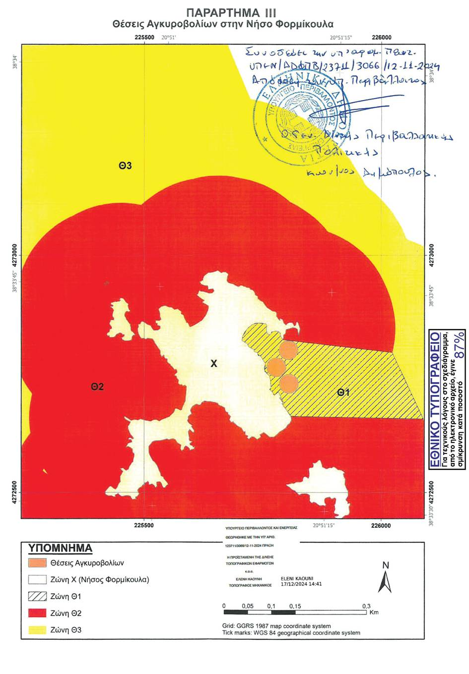
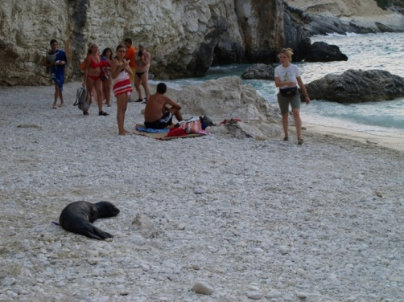
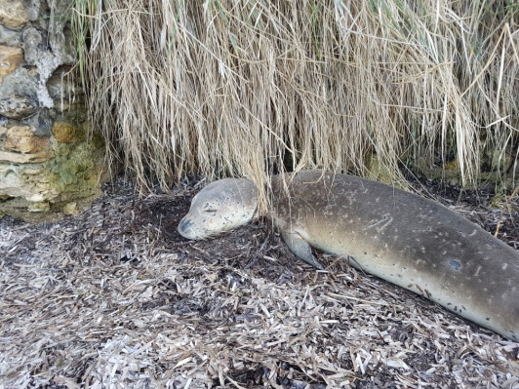
Management Challenges
Limited human resources
Seasonal tourism pressures
Illegal activities
Policy gaps and slow enforcement (response in case of infringements)
Community resistance or misinformation
General cooperation/synergies between stakeholders (competent authorities, Environmental NGOs, research centers/universities, local stakeholders, etc)

Slide 16

Thank you for your attention

